Slide 1

Who will have the next great Craft Brewery?
ST. PETERSBURG
VS.
TAMPA
Researching the
Craft Beer Market

Slide 2


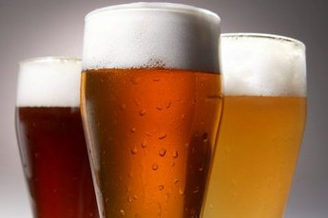

Facts of the Craft Beer Industry
01
04
National Fact
Florida Fact
Overall Beer Market down 1.6%
Craft Beer Market up 3.6%
Ranks 41st in per capita breweries, with only 2 per 100,000 people age 21+
05
02
Florida Fact
National Fact
Ranks 5th for economic impact from craft beer sales of over 3.8 million dollars
Import Beer is up 1.8%
03
06
Florida Fact
Florida Fact
Ranks 7th in the nation with 368 Craft Breweries
Ranks 4th in production of craft beer with over 1.2 barrels produced annually
Notes:
https://unsplash.com/photos/NQymDb5XqC4

Slide 3
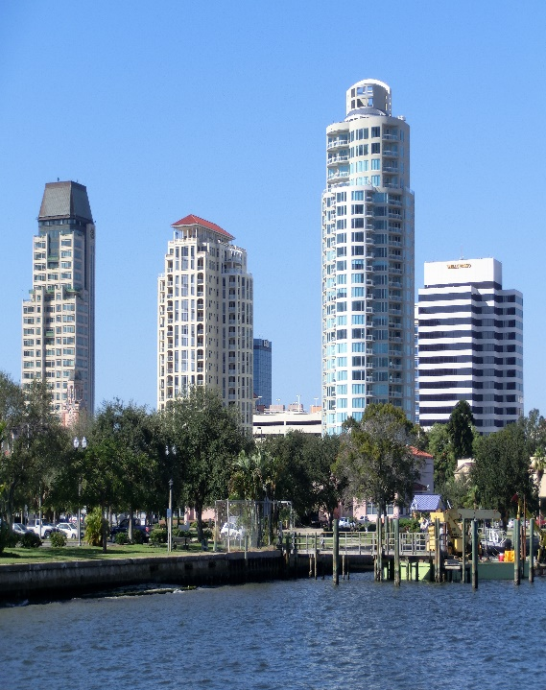
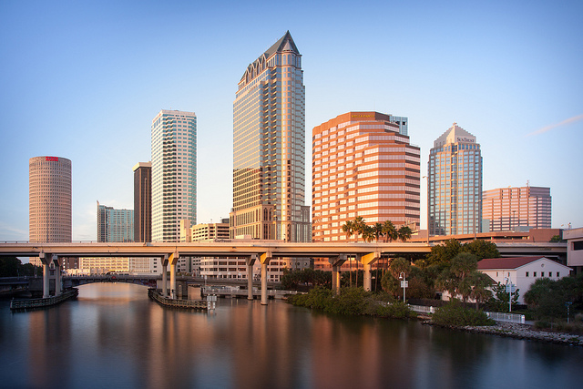
The Battle of the Bay
ST. PETERSBURG
TAMPA
Population:
399,700
Population:
265,351
Notes:
https://unsplash.com/photos/WMD64tMfc4k
https://unsplash.com/photos/MZ5A24H1JqU
https://unsplash.com/photos/e-2KhxOZbuw

Slide 4
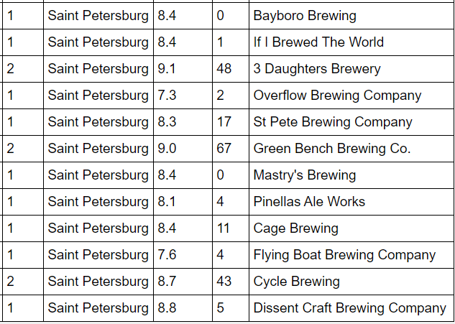
St. Petersburg Breweries
Style | Ratings | Tips | Brewery

Slide 5
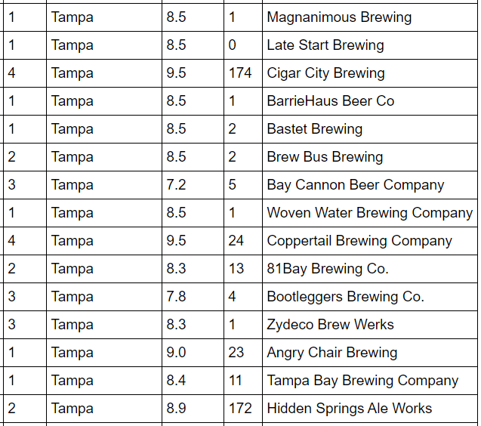
Tampa Breweries
Style | Ratings | Tips | Brewery

Slide 6
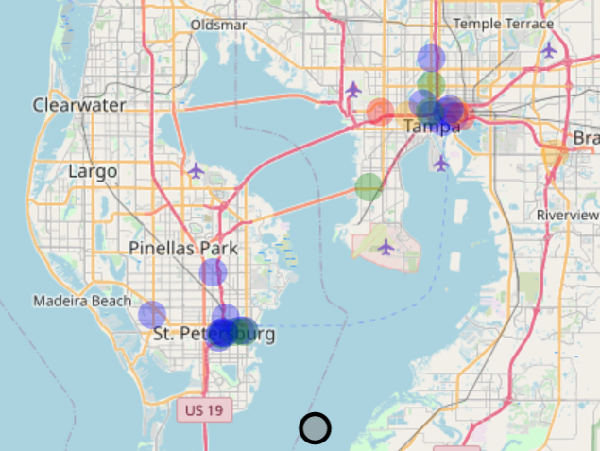
Breweries Mapped by Style

Slide 7

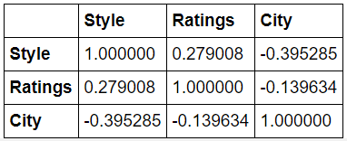
CORRELATION TESTS
Based on the correlation tests you can see there is a positive relationship between the style of brewery and how many ratings they receive.
Notes:
https://unsplash.com/photos/NQymDb5XqC4

Slide 8

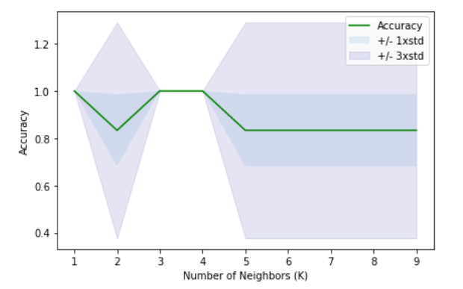
K NEAREST NEIGHBORS
Based on the graph of the accuracy of K Nearest Neighbors, you can see that within 3 to 4 neighbors we can tell what style of brewery there should be. After that it varies slightly but consistently.
Notes:
https://unsplash.com/photos/NQymDb5XqC4

Slide 9




Summary
Currently St. Petersburg has 12 breweries while Tampa has 16. Tampa has both Regional breweries. Tampa has all four styles of breweries while St. Petersburg only has tap houses and micro brews.
St. Petersburg
Tampa
Overall ratings for Tampa are slightly higher with an average of 8.4 while St. Petersburg breweries have an average of 8.4.

Slide 10




Conclusion
Tampa
Given the larger population, better brewery ratings and more diversity withing the types of breweries that Tampa has, it should be the next location of a brewery in the Tampa Bay Region.
The business plan for the next brewery (or any current) should include expansion plans. They should begin as a Tap House and as they grow become a Micro Brew and eventually a Regional Brewer. Brew Pubs are not overly popular or successful so that should not be included in their business plan.

